Slide 1

Instructions for ETF Analyzer
Yu-Ching Liao, Prop. Trading Dept., Futures Prop. Trading Div.

Slide 2
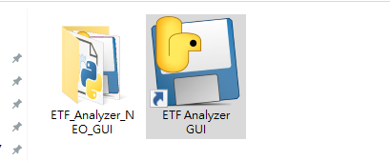
Step 1: Click “ETF Analyzer GUI”.
P.S. This might take about 10 – 20 secs to initialize.
P.S. DO NOT DELETE THE FOLDER “ETF_Analyzer_NEO_GUI”!!

Slide 3
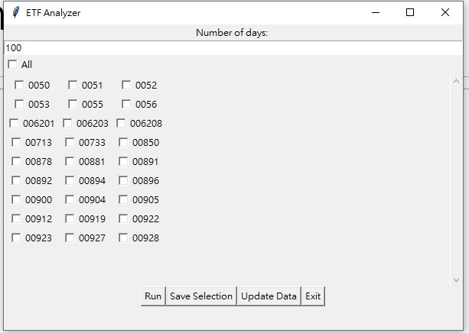
Step 2: Enter the “Number of days” to be tested.

Slide 4
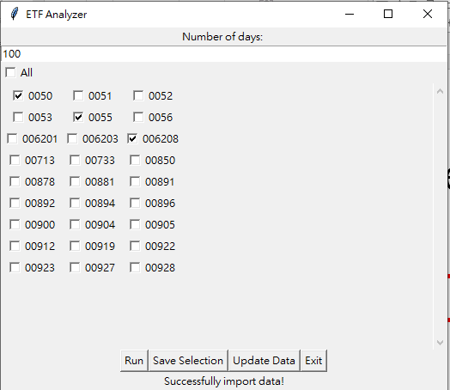
Step 3: Check the ETFs to be tested.

Slide 5
Step 4: Run! (or press Enter)

Slide 6
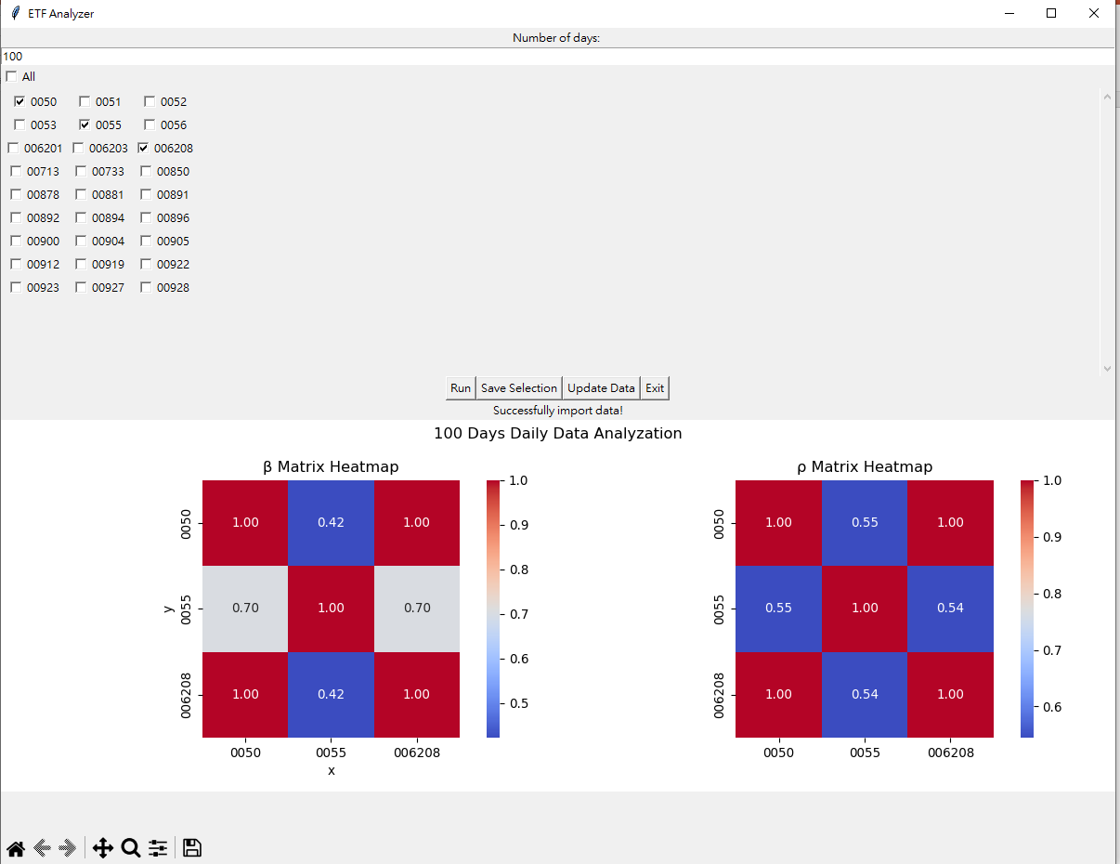
Result:
P.S. We can re-select the variables and re-run the program.

Slide 7
Functions

Slide 8
Save selection
We can save the selections of variables for next time.

Slide 9
Update Data
If SQL Database has been modified, it is better to update the referred database.

Slide 10
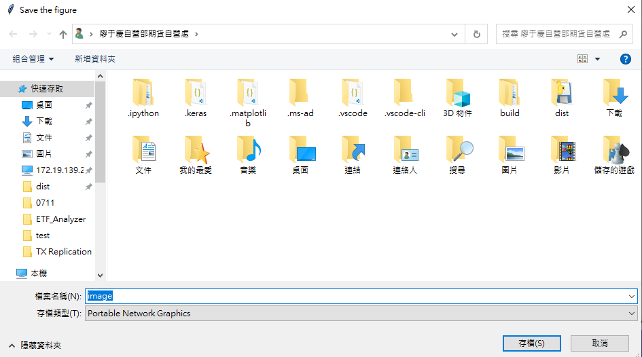
Save the image
We can save the image in selected location.

Slide 11
Possible Error Messages

Slide 12
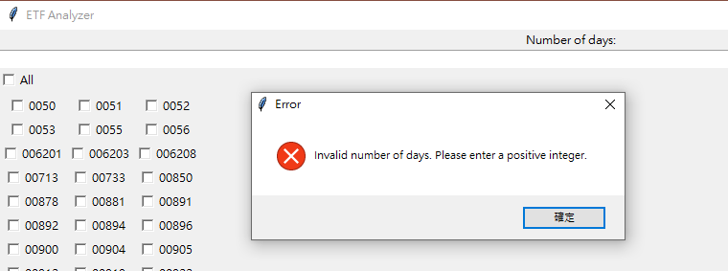
“Invalid number of days.”
Cause: Not entering “positive integer” for “Number of days”.
Solution: Make sure to enter positive integer rather than string or decimals.

Slide 13
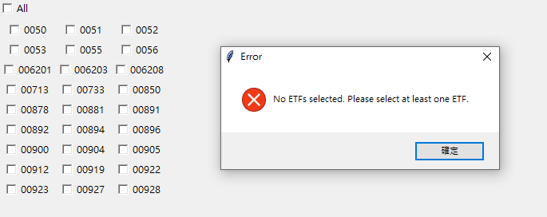
“No ETFs selected.”
Cause: Not selecting any of ETFs.
Solution: Make sure to select at least one ETF to be tested.

Slide 14
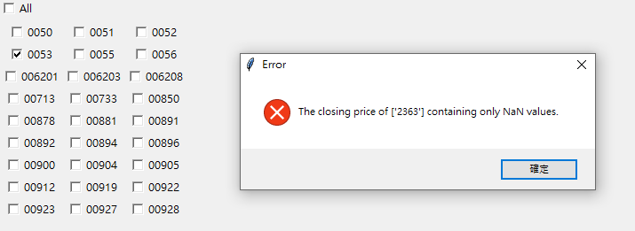
“The closing price of [‘stock ID’] containing only NaN values.”
Cause: All of the closing price of the specific stocks are NaN values.
Solution: Better to inspect the SQL Database. And make sure to press “Update Data” after the modification of SQL Database.

Slide 15
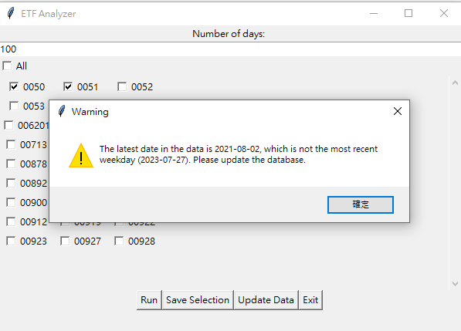
“Warning: The latest date is not the recent weekdays.”
Cause: The database is not updated to the latest weekdays.
Solution: Be sure to update the database to get the latest closing prices and weights.
P.S. We can still get the result with this warning message. Yet it is better to update the database for accuracy.

